Slide 1

What makes the world happy?
Nadia Aldrich Carlos Quiroz Dustin Osterman

Slide 2
What is the World Happiness Report?
First published in 2012 the world happiness report looks at 6 critical variable indicators of a nation’s economic and social development.

Slide 3
The 6 Variables of The World Happiness Report
GDP - Quality of life based on money earned.
Family - Quality of life based on family social life.
Health - Healthcare availability and average life expectancy.
Freedom - Freedom to make life choices.
Corruption - Trust in the Government.
Generosity - Based on a country’s involvement in peacekeeping and global aid
Dystopia - A flat rate score (1.85); the avg lowest happiness score from years past plus a residual value.

Slide 4
Hypothesis #1
If a larger portion of GDP is put into charitable causes, then that country will have a higher happiness score.

Slide 5
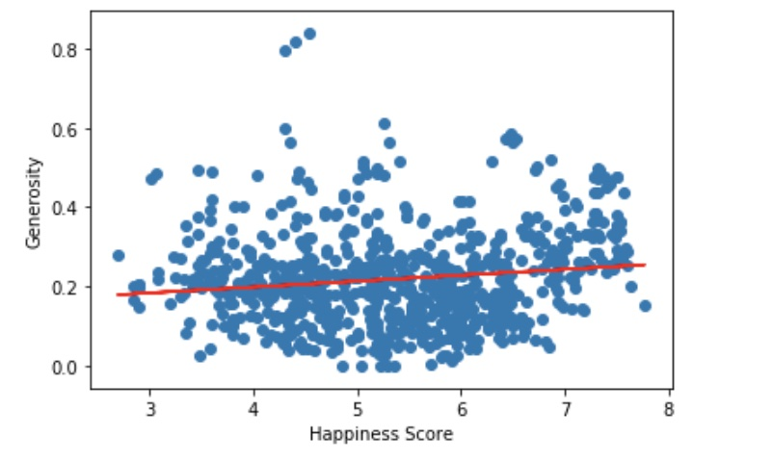
Does generosity have an effect on happiness?
No. In fact, ‘generosity’ is the least impactful of any of our variables on ‘happiness score’.

Slide 6
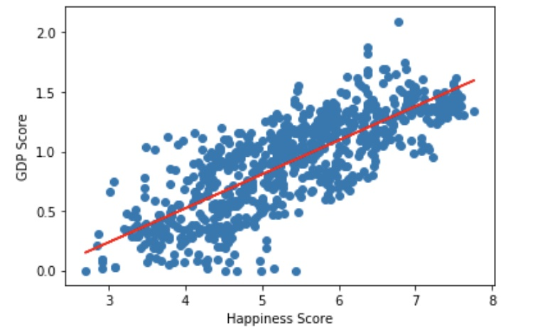
Money!!
Turns out ‘GDP’ is one of the strongest relationship to weather or not a country has a higher ‘happiness score’.
r = .8
Very strong linear relationship.

Slide 7
GPD isn’t the only variable for happiness
If you rank higher in health, family, and freedom then you will have a higher happiness score.

Slide 8
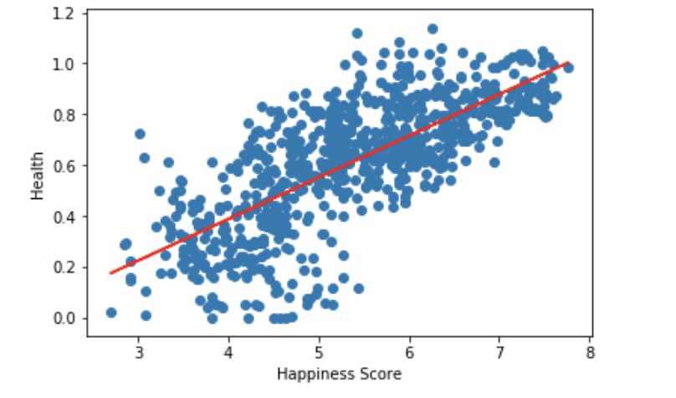
Health
If you have more money you will feel safe in knowing that your medical needs are met.
r = .7
Moderately strong linear relationship.

Slide 9
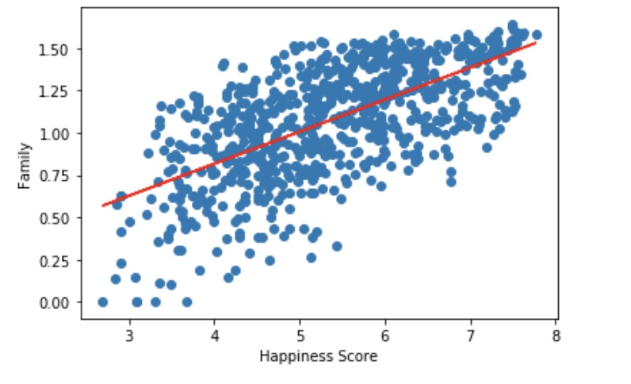
Family
Having a close knit social connection contributes to one's happiness of the heart and mind.
r = .6
Moderately strong linear relationship.

Slide 10
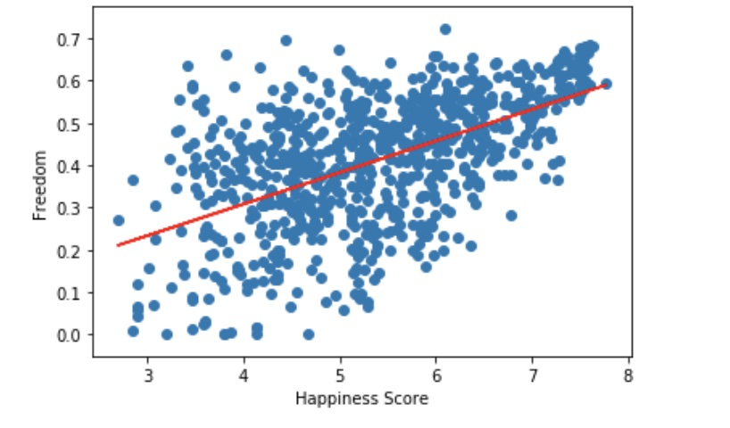
Freedom
The feeling of freedom to do as one pleases will have an overall
r = .6
Moderately strong linear relationship.

Slide 11
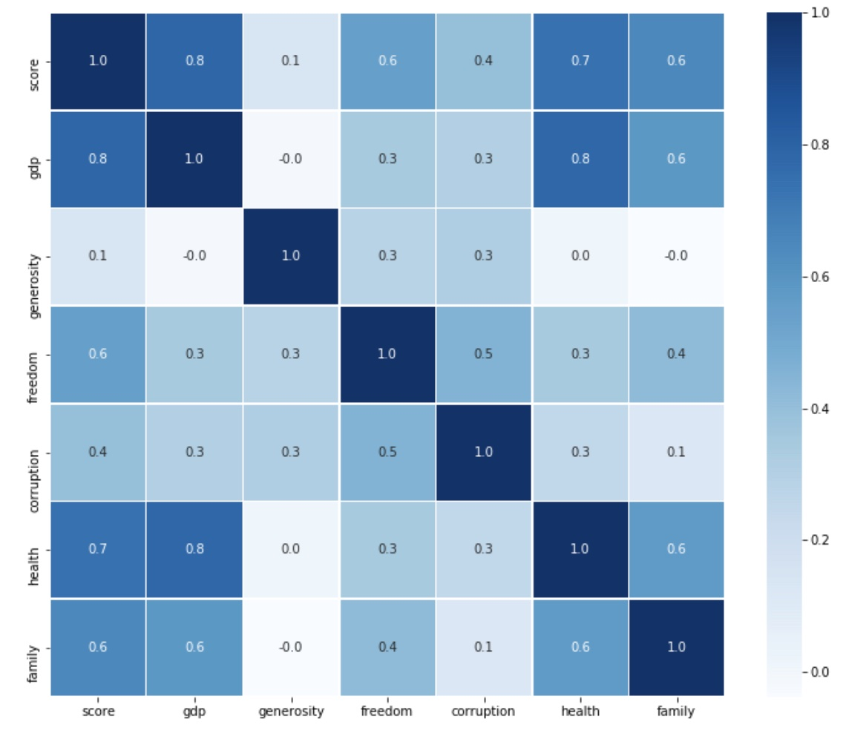
Correlation Map

Slide 12
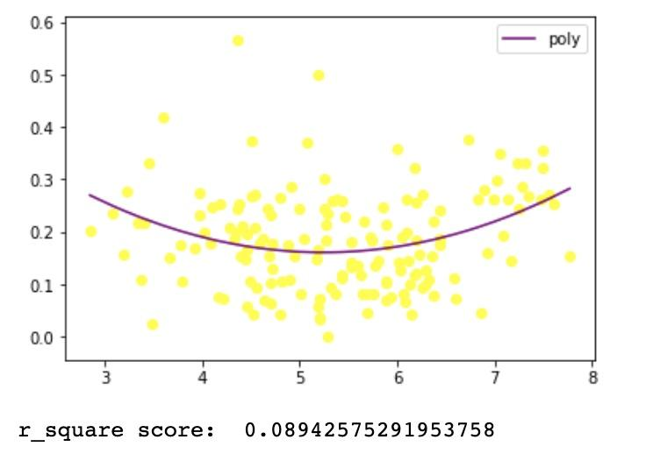
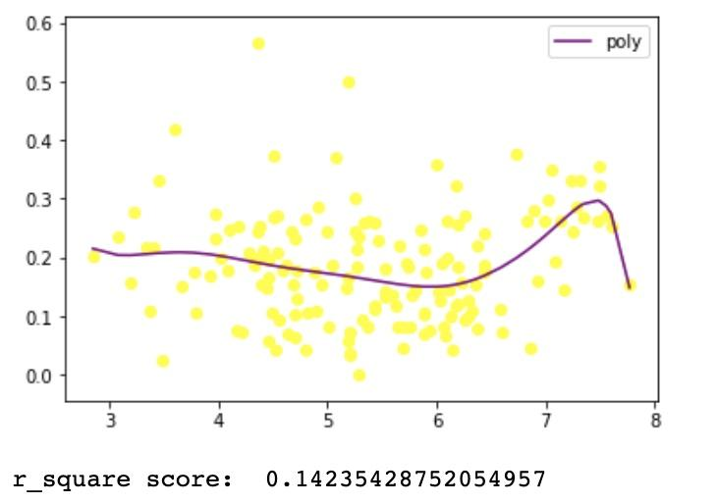
If two variables do not have a strong linear relationship, then we can use a polynomial regression.

Slide 13
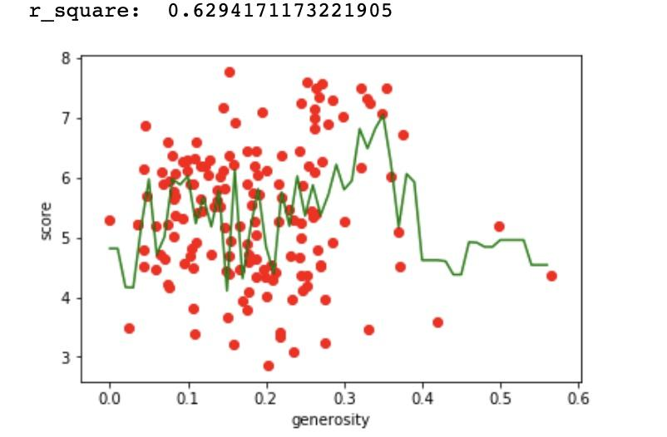
Random Forest Regression

